Slide 1


A Multi-Modality Deep Learning Approach
Coyote Ads Detection
Presented by :-
Dr. Faryaneh Poursardar
Lecturer at Computer Science Department
04/18/2023
@Faryane @WebSciDL

Slide 2

A High-Level Look
Source: https://jalammar.github.io/illustrated-transformer/

Slide 3

A High-Level Look

Slide 4

Encoders Decoders

Slide 5
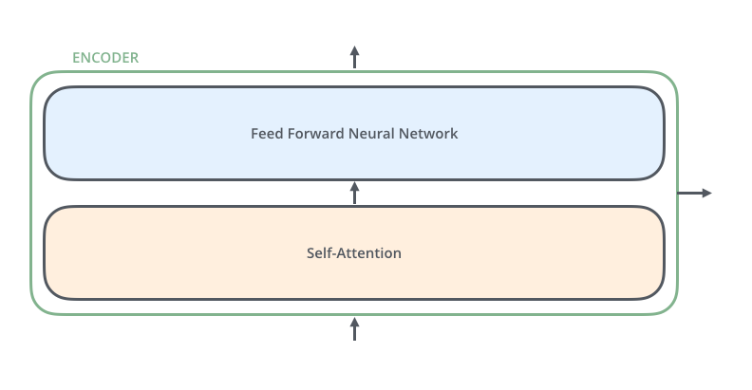
Encoders Decoders

Slide 6

Encoders Decoders

Slide 7
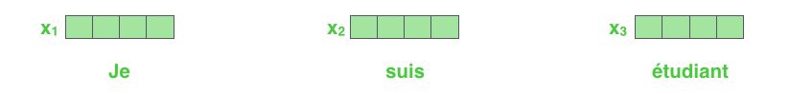
Bringing The Tensors Into The Picture

Slide 8
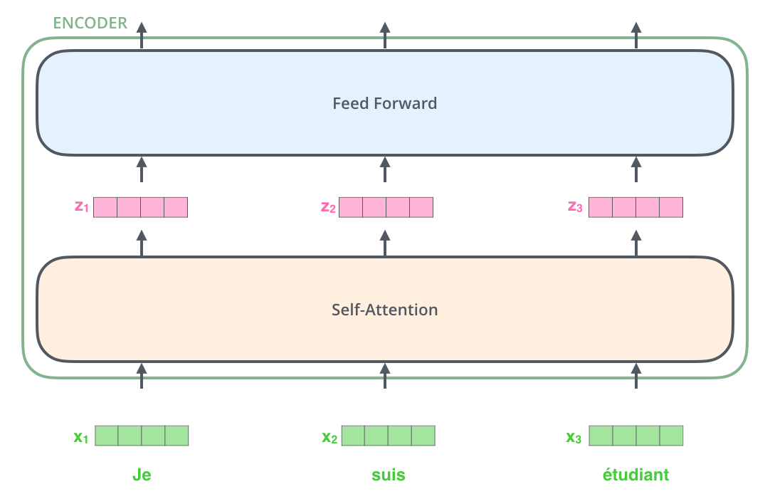
Bringing The Tensors Into The Picture

Slide 9
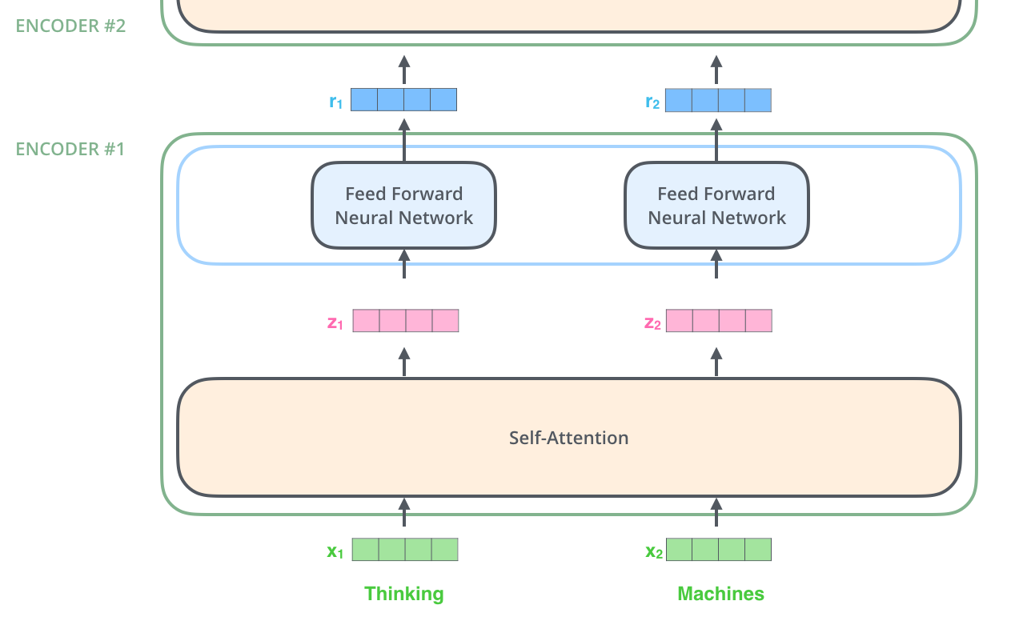
Now We’re Encoding!

Slide 10

Self-Attention at a High Level

Slide 11

Self-Attention in Detail
Multiplying x1 by the WQ weight matrix produces q1, the "query" vector associated with that word. We end up creating a "query", a "key", and a "value" projection of each word in the input sentence.

Slide 12
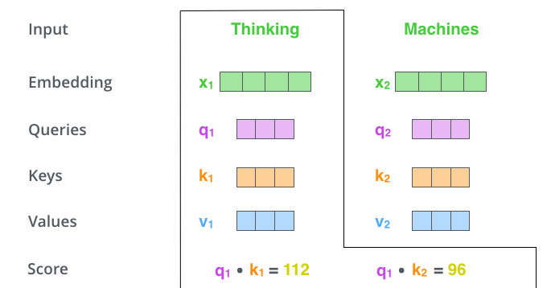
“query”, “key”, and “value”

Slide 13
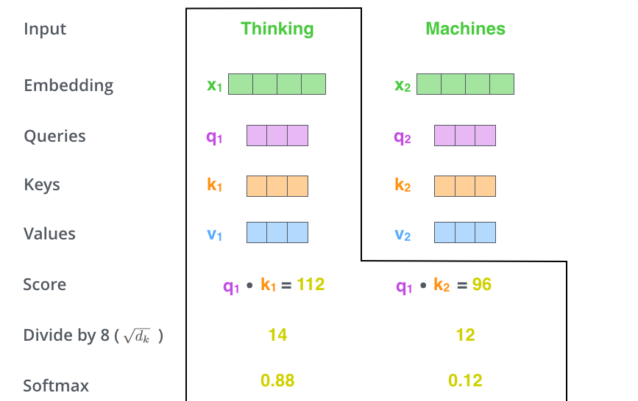
“query”, “key”, and “value”

Slide 14

“query”, “key”, and “value”

Slide 15
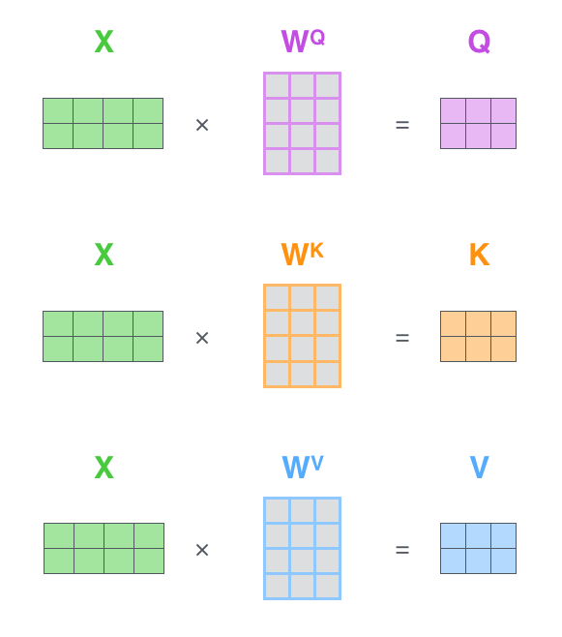
Matrix Calculation of Self-Attention

Slide 16

Matrix Calculation of Self-Attention

Slide 17
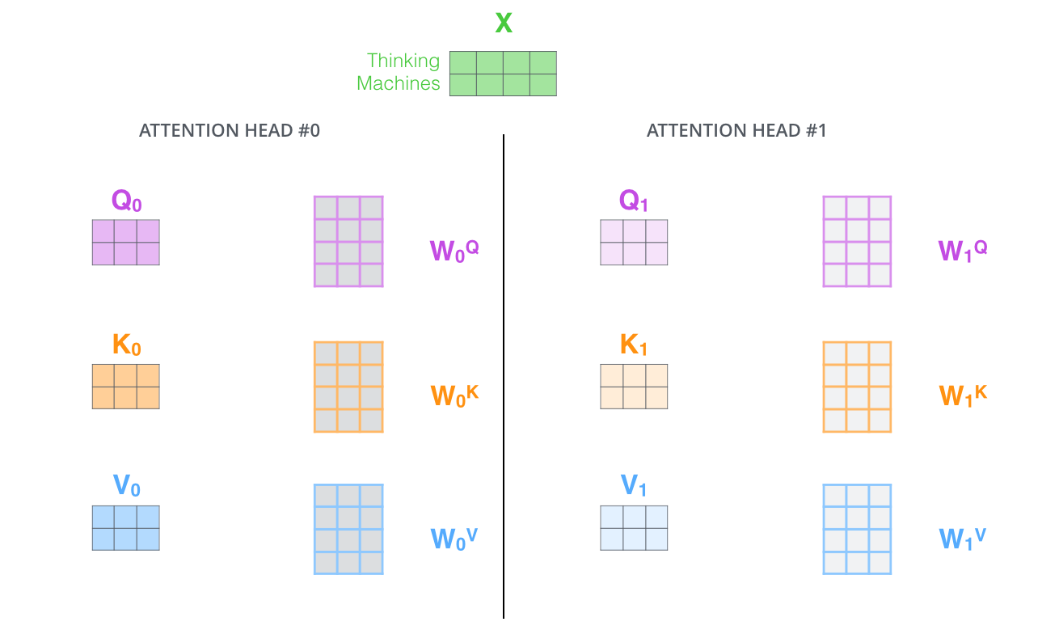
The Beast With Many Heads

Slide 18
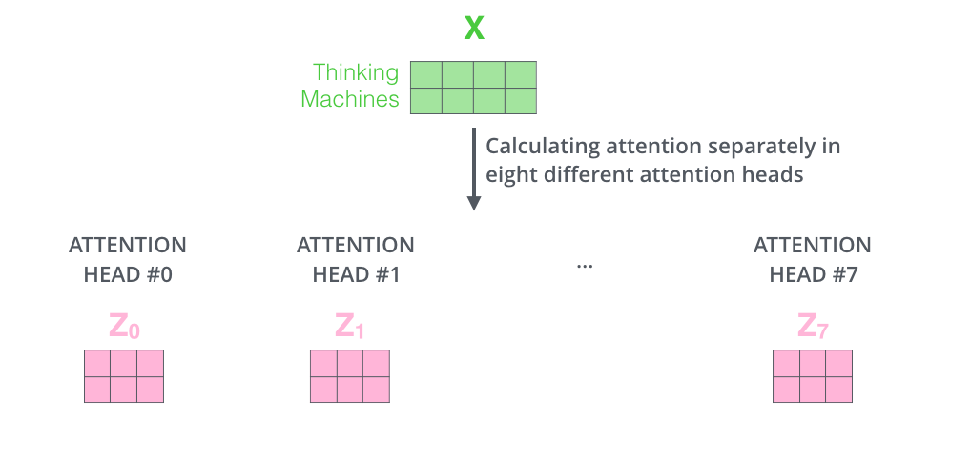
The Beast With Many Heads

Slide 19
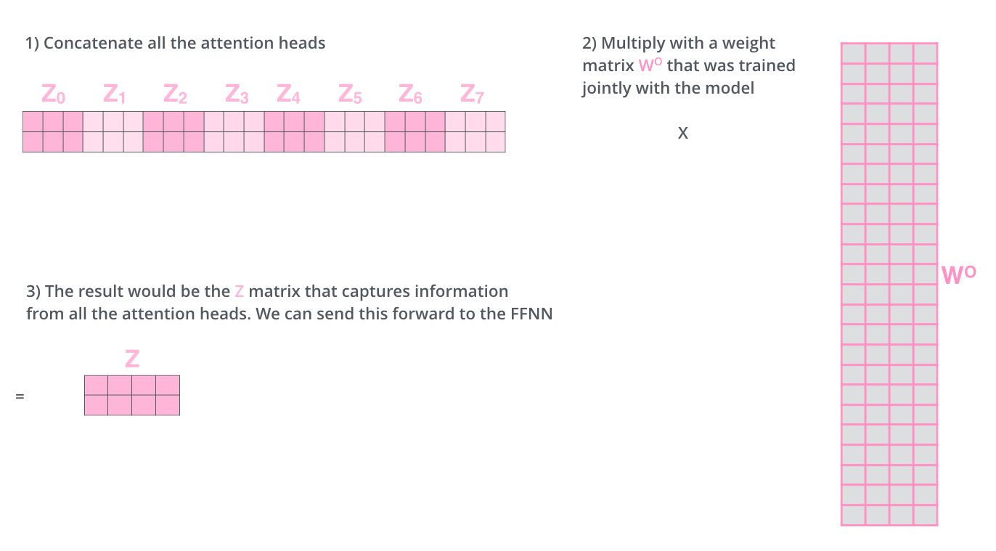
The Beast With Many Heads

Slide 20

The Beast With Many Heads

Slide 21
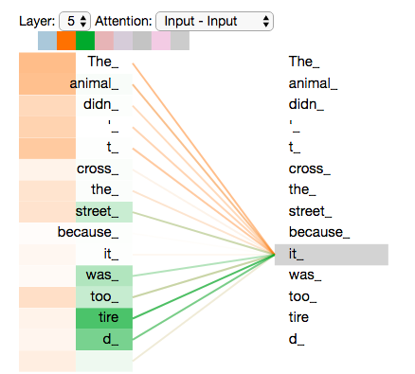

Slide 22
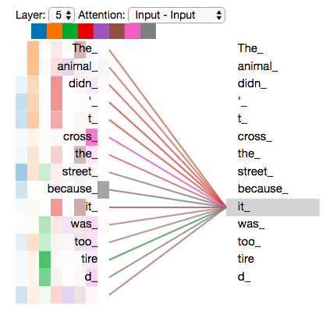

Slide 23
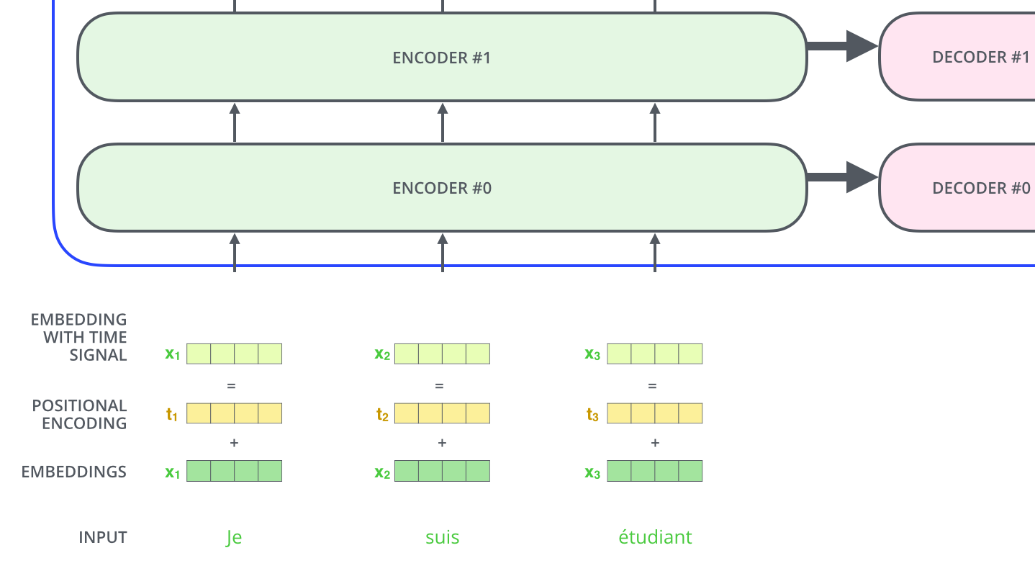
Representing The Order of The Sequence Using Positional Encoding

Slide 24
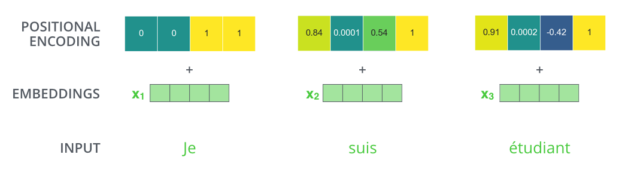
Representing The Order of The Sequence Using Positional Encoding

Slide 25
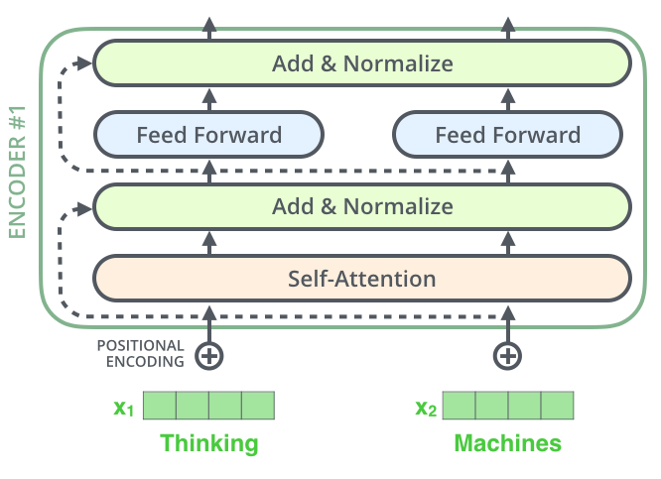
The Residuals

Slide 26

The Residuals

Slide 27

The Residuals

Slide 28

The Decoder Side

Slide 29
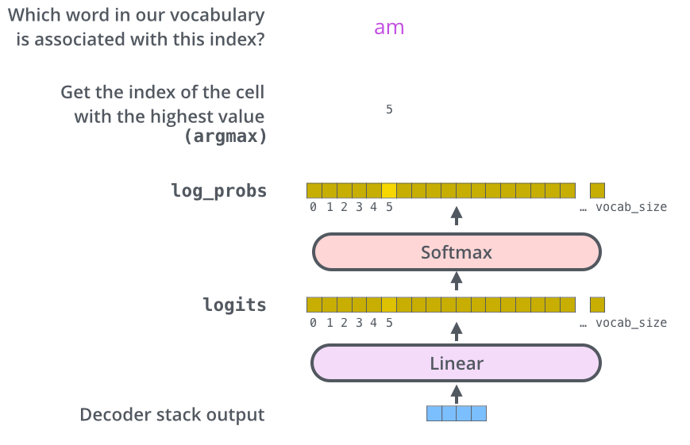
The Decoder Side

Slide 30
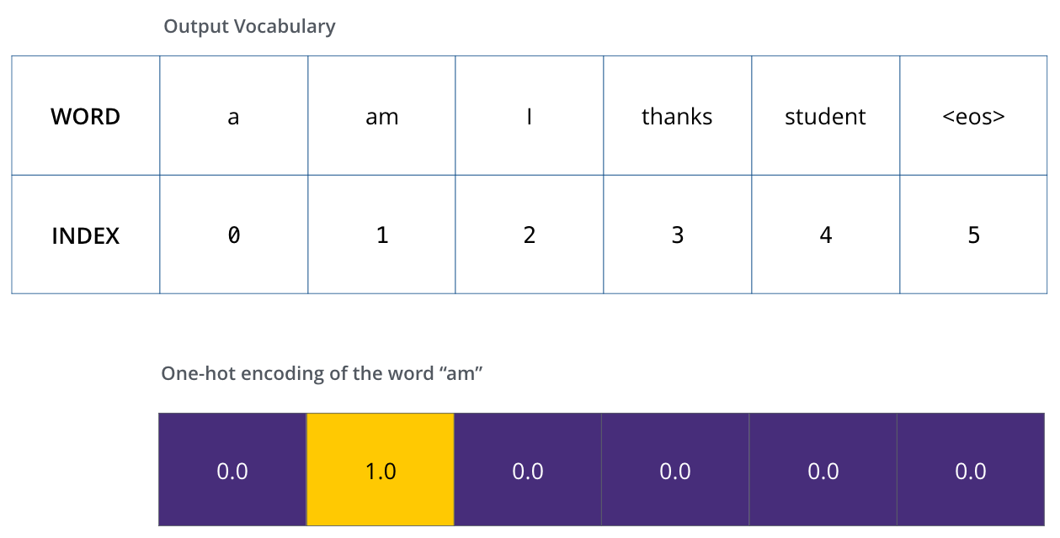
The Decoder Side

Slide 31
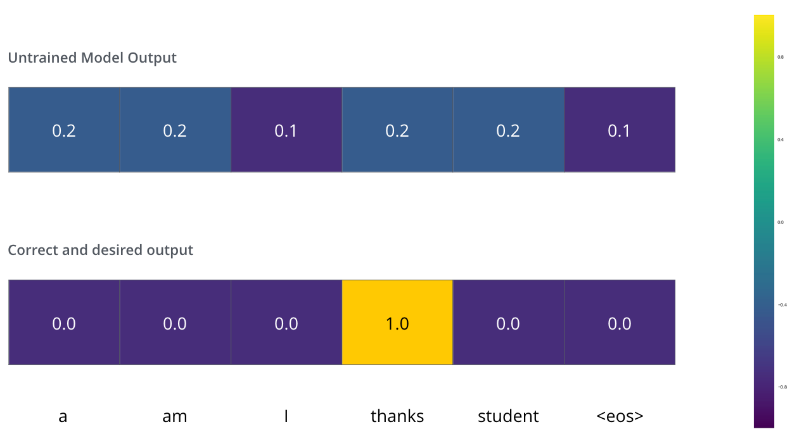
The Decoder Side
Since the model's parameters (weights) are all initialized randomly, the (untrained) model produces a probability distribution with arbitrary values for each cell/word. We can compare it with the actual output, then tweak all the model's weights using backpropagation to make the output closer to the desired output.

Slide 32
The Final Linear and Softmax Layer

